Slide 1

Empirical Analysis of Machine Learning Algorithms ( supervised and unsupervised ) on Software Defect Prediction Datasets
Presented by :
Subhash and Yogesh Singh

Slide 2
INTRODUCTION
Software quality is one of the essential aspects of a software. With increasing demand, software designs are becoming more complex, increasing the probability of software defects.
Software defect prediction studies aim to predict defect-prone components before the testing stage of the software development process.
While a few software defect prediction models have been developed for mobile applications, a systematic overview of these studies is still missing.

Slide 3
OBJECTIVE
A comprehensive comparative study of clustering – based supervised and unsupervised defect prediction models

Slide 4
DATASETS USED
Ar1
Ar3
Ar4
Ar5
Ar6
Cm1
Jm1
Mw1
Kc2
Kc3
Mc1
Mc2
Pc1
Pc2
Pc3
Pc4
Pc5

Slide 5
Imbalanced Data
Previous research studies on defect prediction demonstrate that 80% of the defects occur in very few modules (20%). This indicates that defective classes are present in minority as compared to non-defective classes, which results in imbalanced datasets.
For balancing the data, we have used SMOTE oversampling technique.

Slide 6
ALGORITHMS USED
Supervised Algorithms
Naïve Bayes (NB)
Support Vector Machine (SVM)
K-nearest Neighbours (KNN)
Random Forest (RF)
Logistic Regression (LR)

Slide 7
Continued..
Unsupervised Algorithms
K-means (KMS)
Mini Batch K-means (MBM)
Agglomerative Heirarchical Clustering (AHC)
Balanced iterative reducing and clustering using hierarchies (BIRCH)
Spectral Clustering (SC)
Guassian
Affinity Propagation (AP)
Ordering Points To Identify Clustering Structure (OPTICS)
Mean Shift (MS)
Density-Based Spatial Clustering of Applications with Noise (DBSCAN)
X -means

Slide 8
Feature Selection Technique
Some of the datasets have high number of features.
So for eliminating redundant and irrelevant data , we have used feature selection technique using Recursive Feature Elimination(RFE).
It fits a model and removes the weakest feature (or features) until the specified number of features is reached.
We have used LR to choose features.

Slide 9
Labelling Technique
In unsupervised clustering the labelling was done with the help of SFM technique
This technique clusters the modules into two groups and calculates the Sum of Feature values of each Module (SFM), then calculates the Average value of the SFMs (ASFM) for all modules in each cluster.
The cluster with larger ASFM is labeled as defective, and another cluster is labeled as non-defective.

Slide 10
Performance Parameters
We used three evaluation indicators for our models -
Accuracy
F1-score
MCC

Slide 11
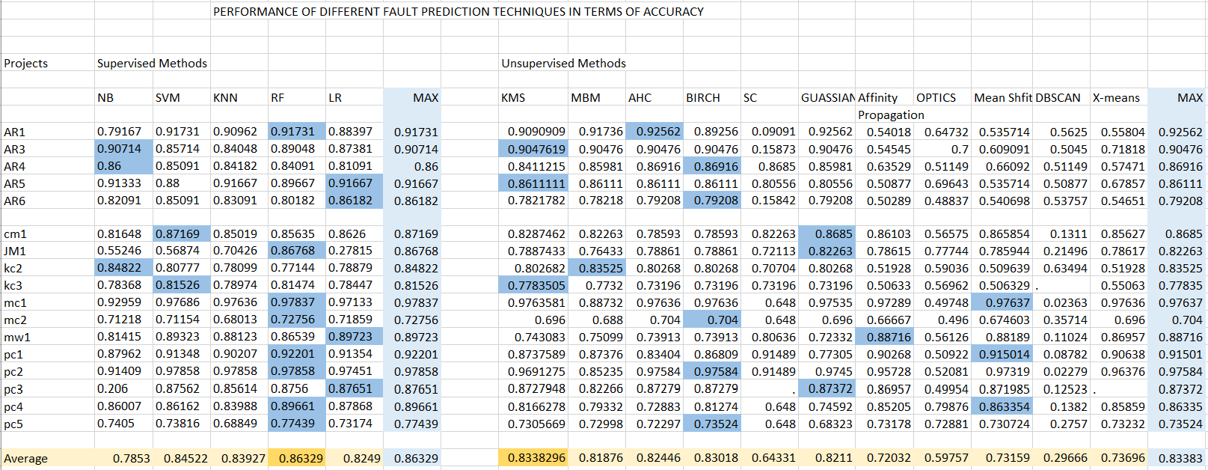
Accuracy

Slide 12
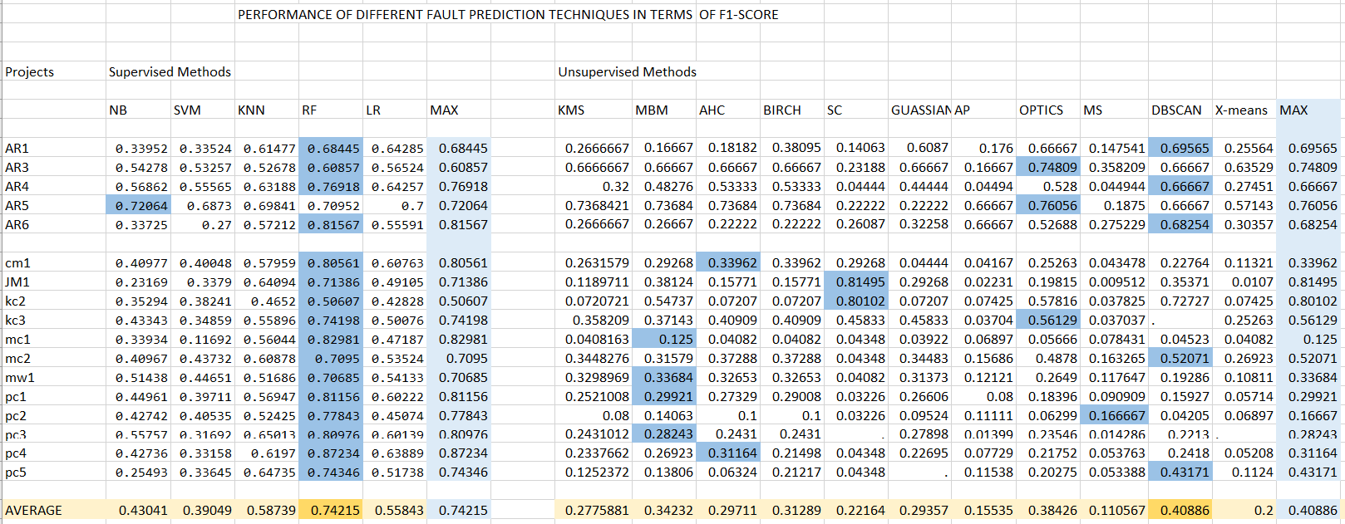
F1-score

Slide 13
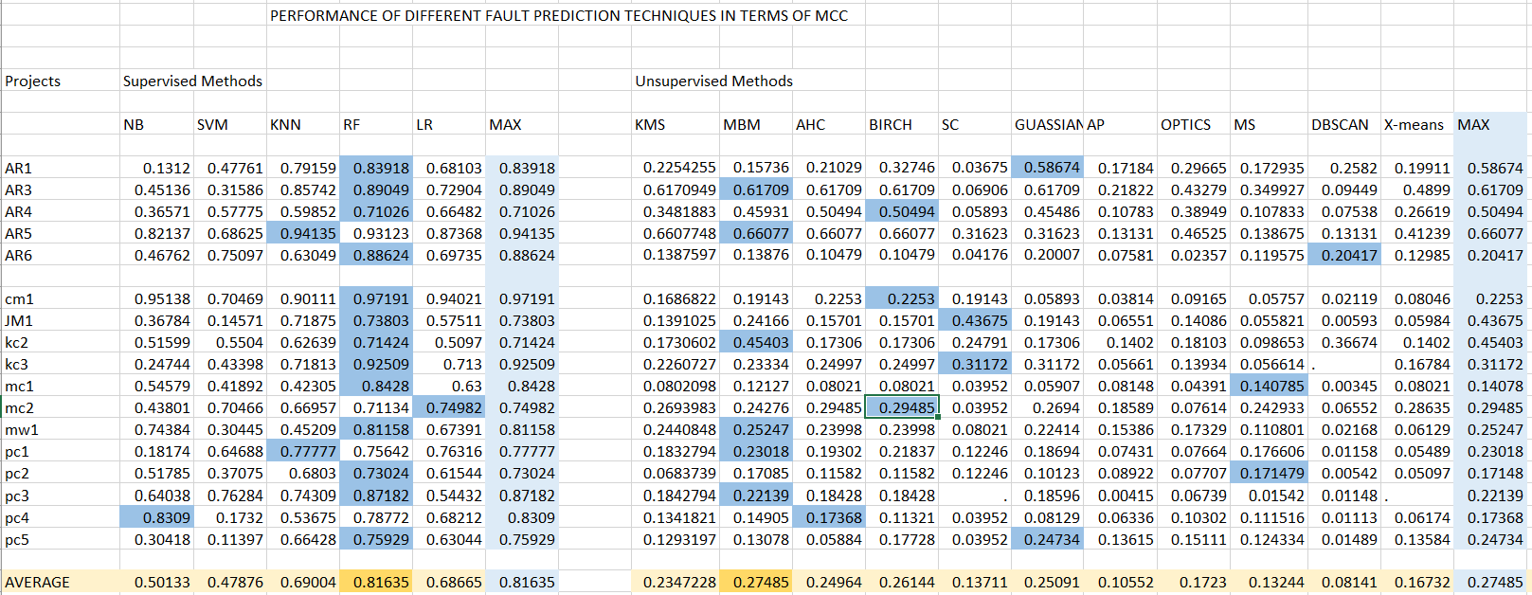
MCC

Slide 14
Experimental Results
Firstly we are using accuracy performance indicator. If we compare supervised algorithms only, RF performed better over other algorithms. In unsupervised models , KMS model performed better over other models.
If we see MCC performance of our models we find that RF in supervised model family and MBM in unsupervised model family performed better.
But when we have an imbalanced data ,accuracy is not a good metric. So we are making conclusion on the basis of f1-score. To sum up, on defect data we can say that Random Forest in supervised model family and DBSCAN in unsupervised model family performed best on f1-score performance indicator.

Slide 15
THANK YOU

